Slide 1
Will Code For Food
Brian, Gavin, Kayla, Mallika, Mason, and Shelli

Slide 2
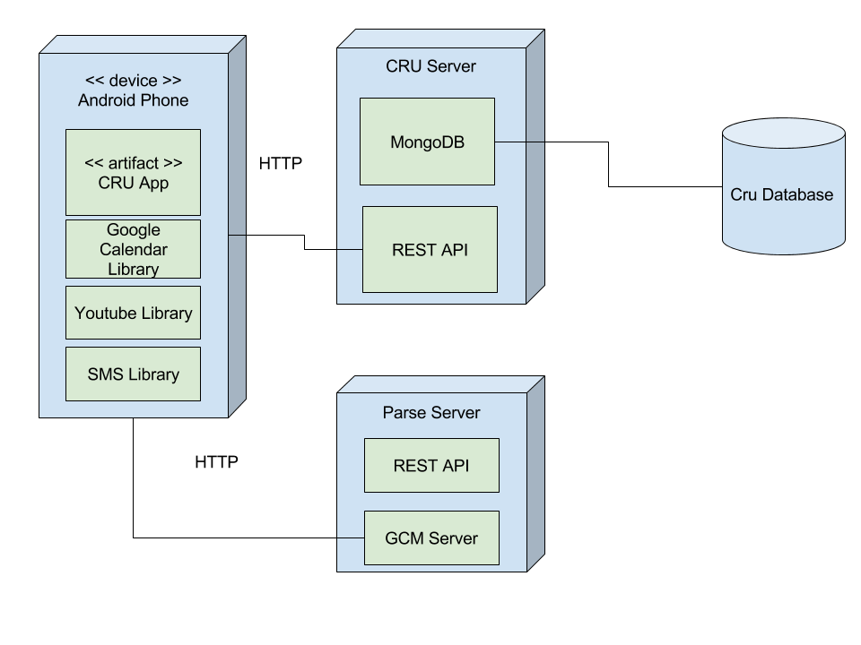
Deployment Diagram

Slide 3
Horizontal Prototype

Slide 4
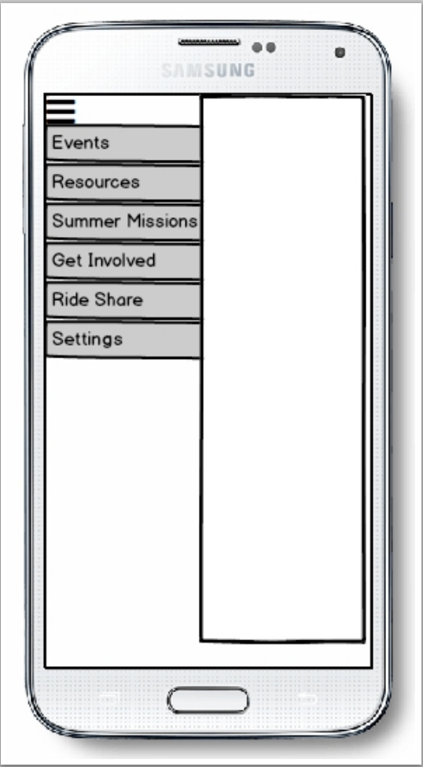
Option Menu

Slide 5
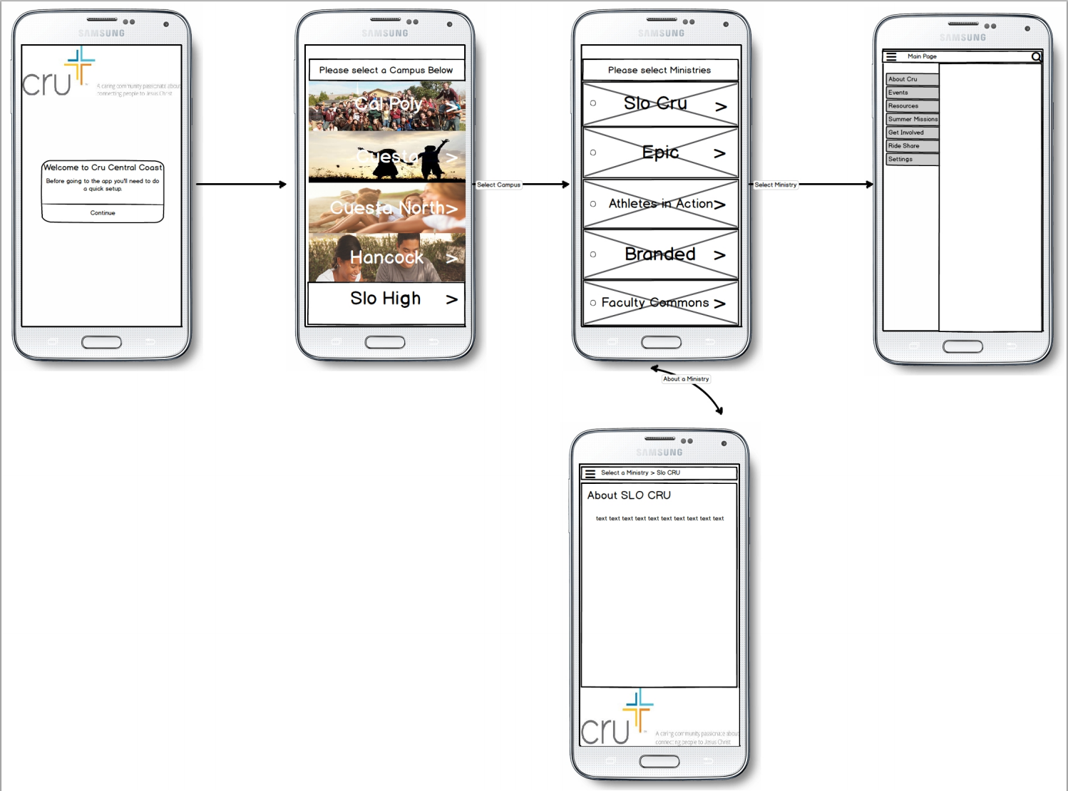
First Time Use

Slide 6
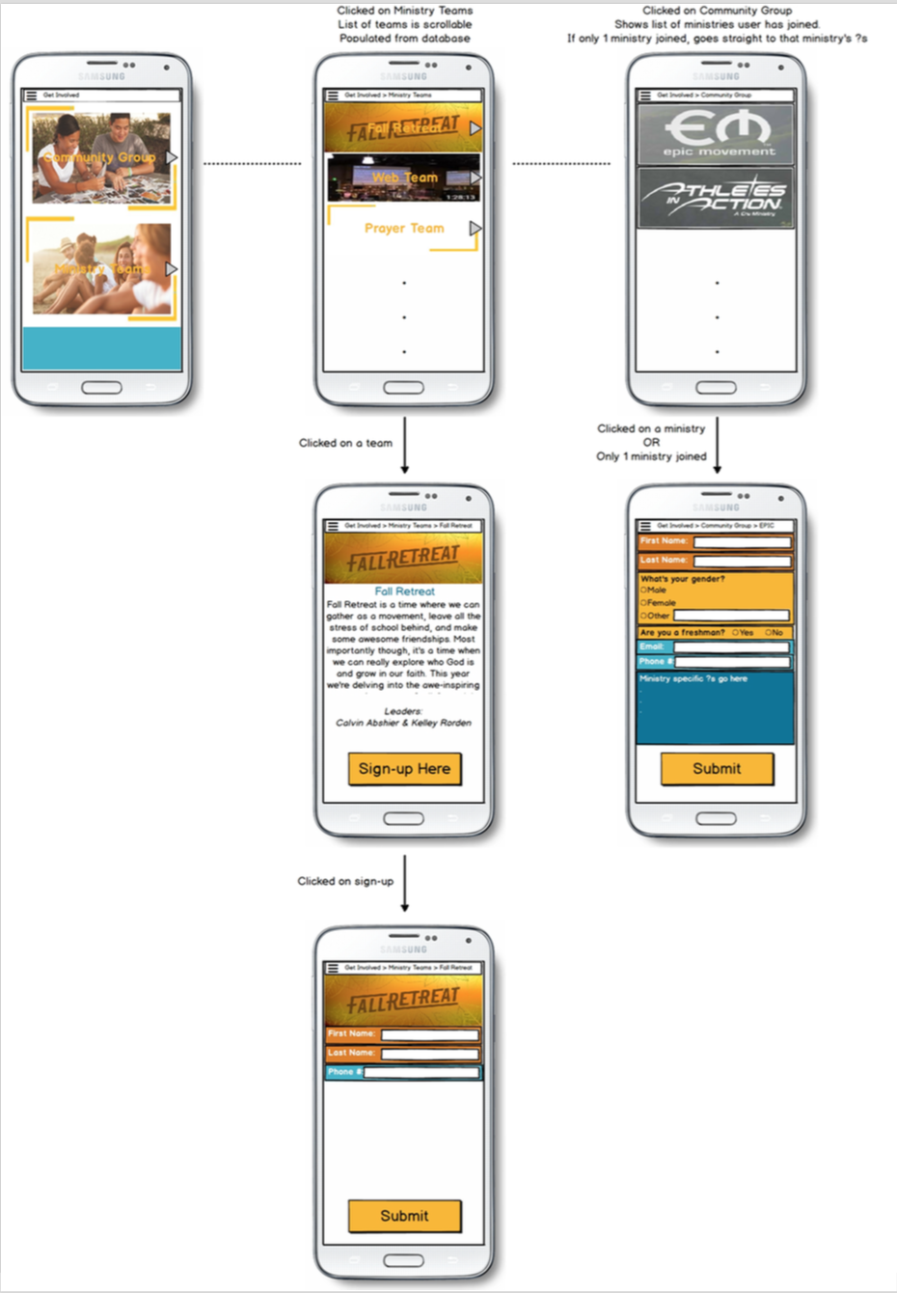
Get Involved

Slide 7
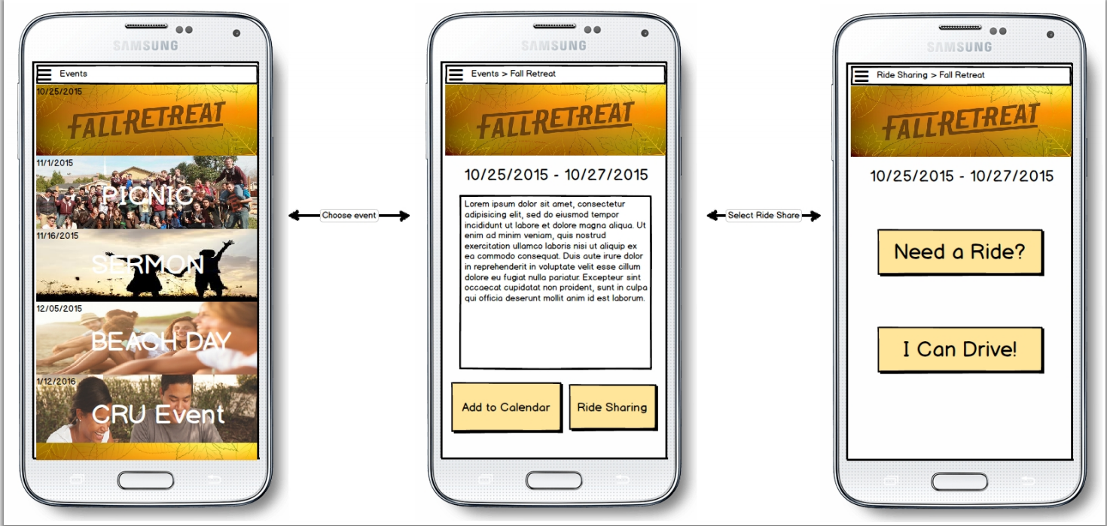
Events

Slide 8
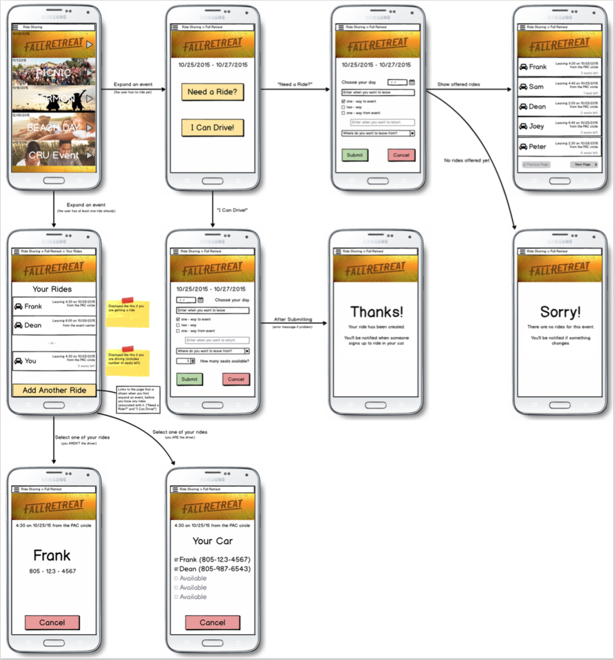
Ride Sharing

Slide 9
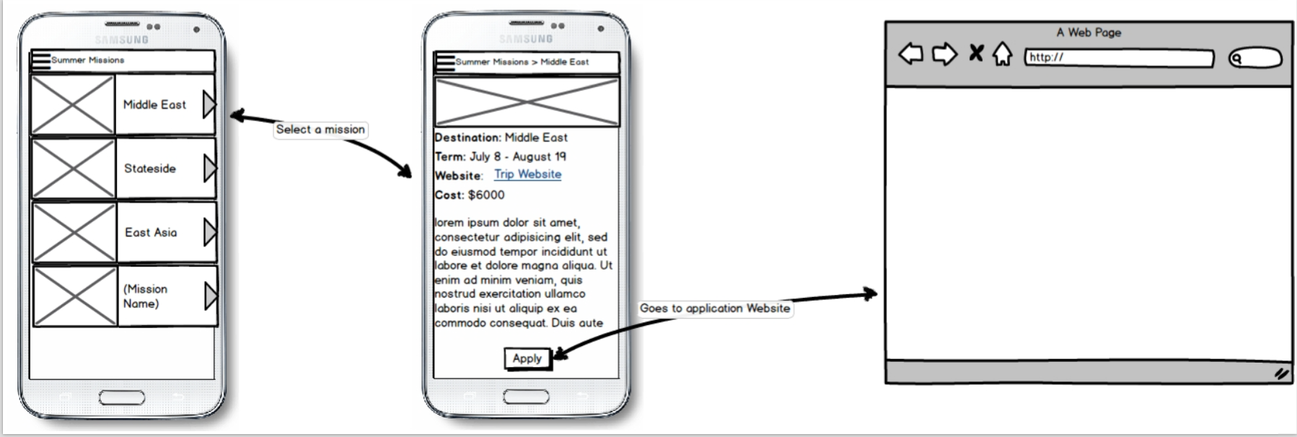
Summer Mission

Slide 10
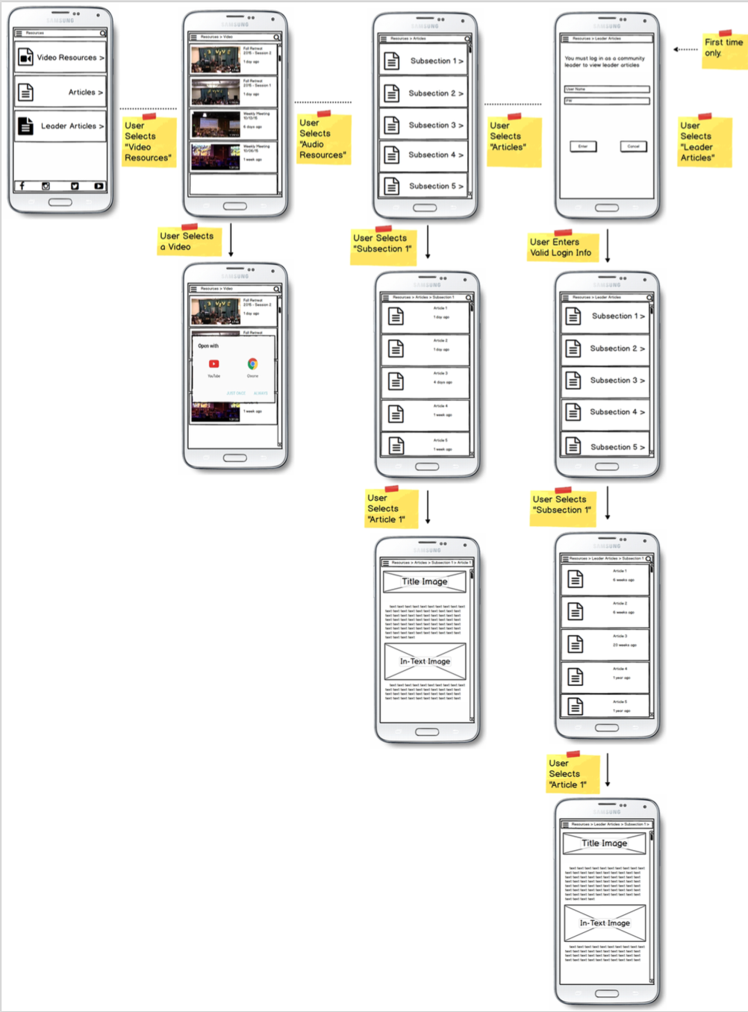
Resources

Slide 11
Architecture Diagrams

Slide 12
Common Class Diagram

Slide 13
Vertical Prototype

Slide 14

Demo!

